Slide 1


React JS
(React design principles)
Lecture-20

Slide 2
Today’s Agenda
React Design Principles
Recommended Way Of State Updation
What To Keep In State ?
Data Flow In State
Exercises

Slide 3
React Design Principles
In order to become a good React developer , there are certain guidelines which facebook has provided and we must follow.
These are called React Design Principles

Slide 4
React Design Principles
These will not only make our apps compliant with React standards but will also help us make the app bug free
There are lot many things that facebook recommends and we will start with 2 top principles:
The first part deals with the way state must be handled
The second part deals with the way data flow

Slide 5
How To Update State
Based On Previous Value ?
One of the most common scenarios in React is to update the state based on its previous value
For example: In a counter based application we would have to increment the state by 1 or any number based on the previous value

Slide 6
How To Update State
Based On Previous Value ?
A very common solution that comes to our mind is to simply pass the expression to increment the value to the method this.setSate() , as shown below:
this.setState({ counter: this.state.counter + 1 });

Slide 7
How To Update State
Based On Previous Value ?
Although this works successfully , but suppose we want to increment the state by 3 and due to some reason instead of incrementing directly by 3 , we repeat the same call to setSate() 3 times as shown below:
this.setState({ counter: this.state.counter + 1 });
this.setState({ counter: this.state.counter + 1 });
this.setState({ counter: this.state.counter + 1 });
The behaviour of the code will be very surprising as it will still increment the counter by 1 only

Slide 8
Why Did This Happen ?
Recall what we learnt about state updation-
Call to setState() is a request rather than an immediate command to update the component. For better perceived performance, React may delay it, and then update several components in a single pass
So in our case this is actually what React is doing , it is simply squashing all the three calls to setSate() into one and picking up only the last call

Slide 9
Solution
If a call to setState() uses the current value while calculating the next value then it is best to pass a callback function to the updater argument of setState()
Recall that the setState() method has the following syntax:
setState(updater, [callback])
updater can either be a function or an object
We are not talking about this callback.
We are talking about callback to be passed as first argument

Slide 10
Alternate Syntax
setState(callback)
This callback will be a function and must follow 2 rules:
It must accept an argument representing the current state object
It must return an object representing the new state

Slide 11
Solution
MyClicker.js
import React, { Component } from "react";
class MyClicker extends Component {
constructor() {
super();
this.state = { counter: 1 };
this.handleClick = this.handleClick.bind(this);
this.handleTripleClick = this.handleTripleClick.bind(this);
}
increment(prevState) {
return { counter: prevState.counter + 1 };
}
handleTripleClick() {
this.setState(this.increment);
this.setState(this.increment);
this.setState(this.increment);
}
handleClick() {
this.setState({ counter: this.state.counter + 1 });
}
render() {
return (
<div>
<h2>Counter is:{this.state.counter}</h2>
<button onClick={this.handleClick}>Increment Counter</button>
<button onClick={this.handleTripleClick}>Triple Increment</button>
</div>
);
}
}
export default MyClicker;

Slide 12
Another Solution
MyClicker.js
handleTripleClick() {
this.setState((prevState) => {
return { counter: prevState.counter + 1 };
});
this.setState((prevState) => {
return { counter: prevState.counter + 1 };
});
this.setState((prevState) => {
return { counter: prevState.counter + 1 };
});
}

Slide 13
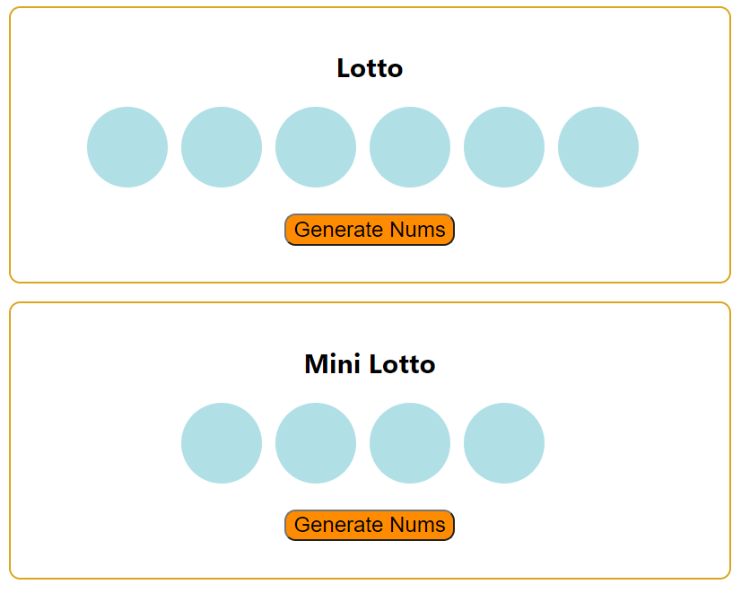
Think About The Components
And Logic Of This App

Slide 14
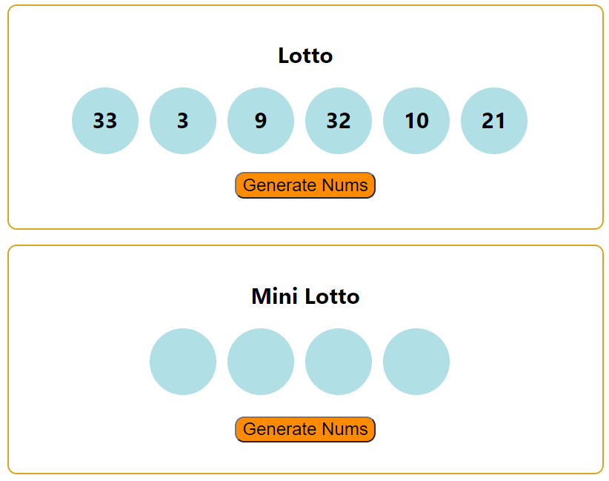
Think About The Components
And Logic Of This App

Slide 15
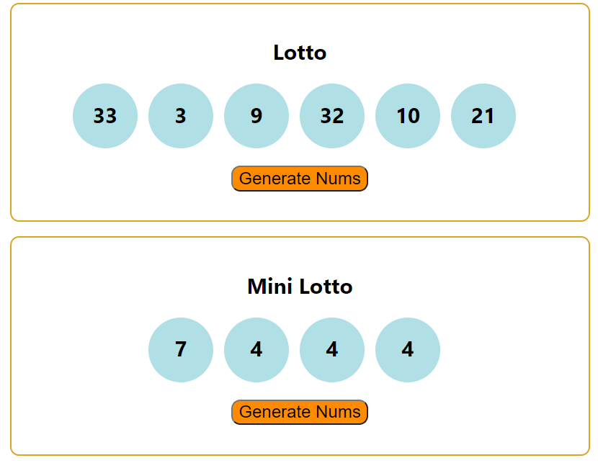
Think About The Components
And Logic Of This App

